Slide 1
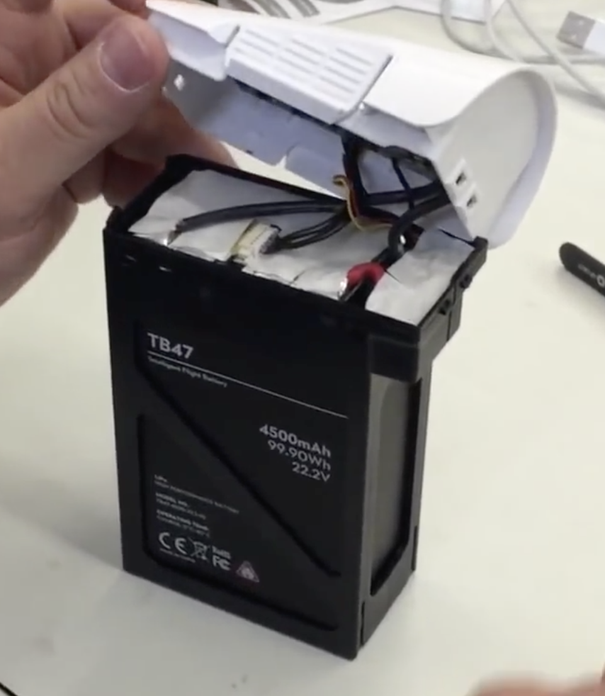
Battery control from circuit
Detach to avoid accidentally activating the battery &
perhaps getting shocked

Slide 2
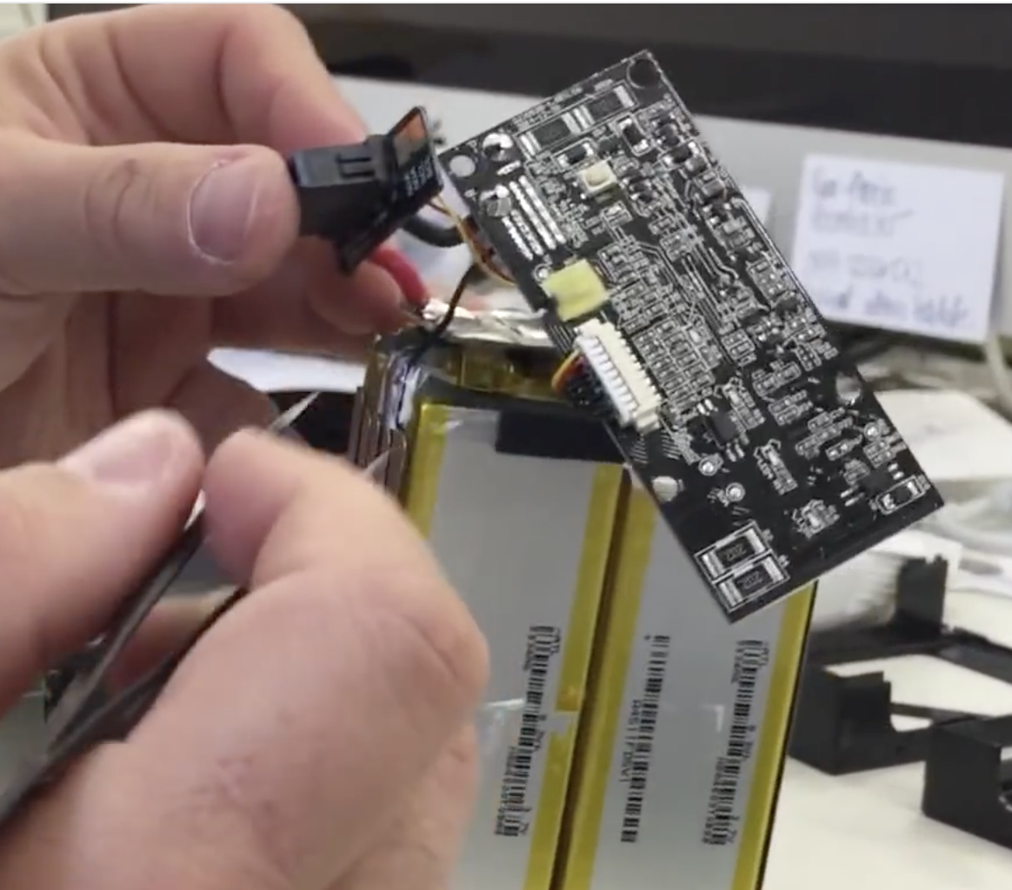
NTC Temperature sensor

Slide 3
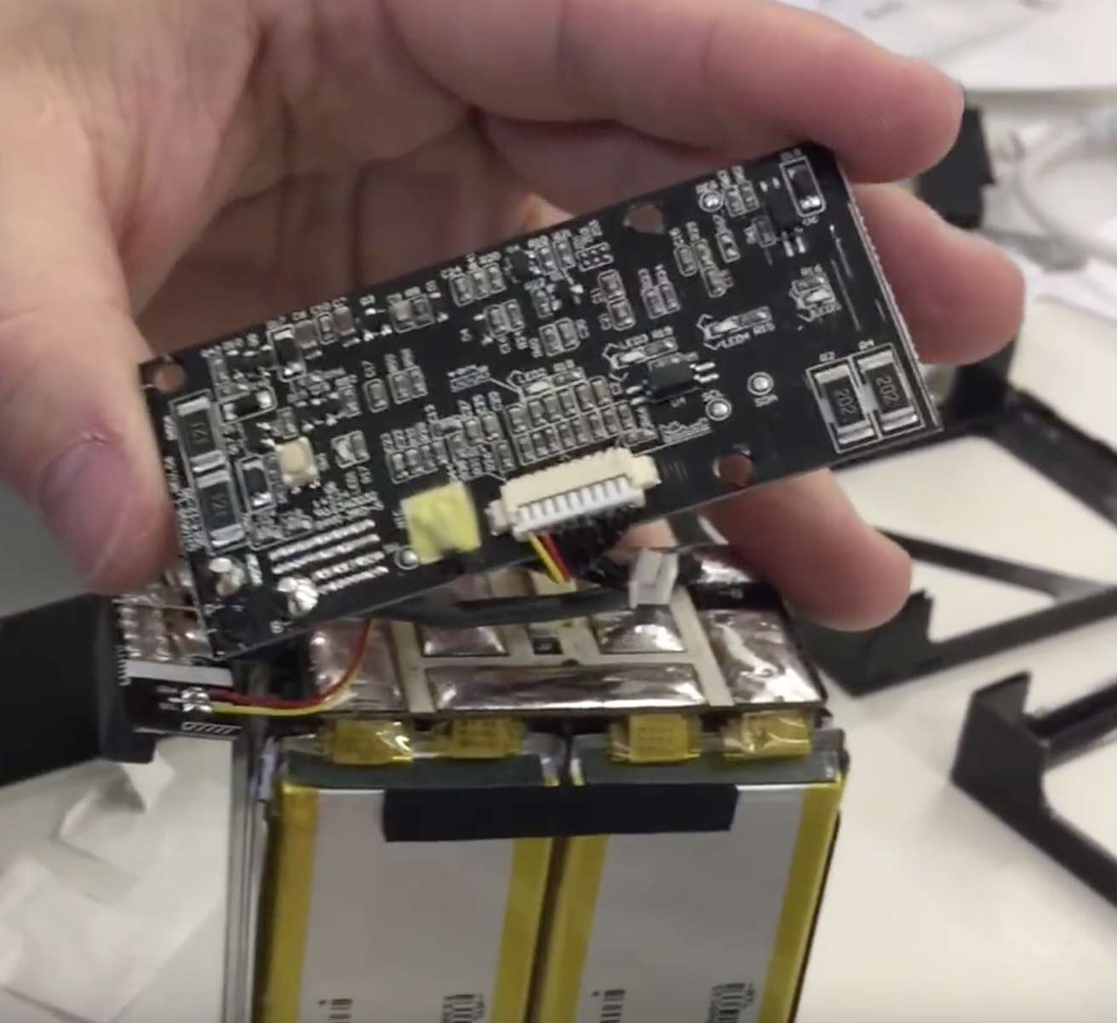
Power switch

Slide 4
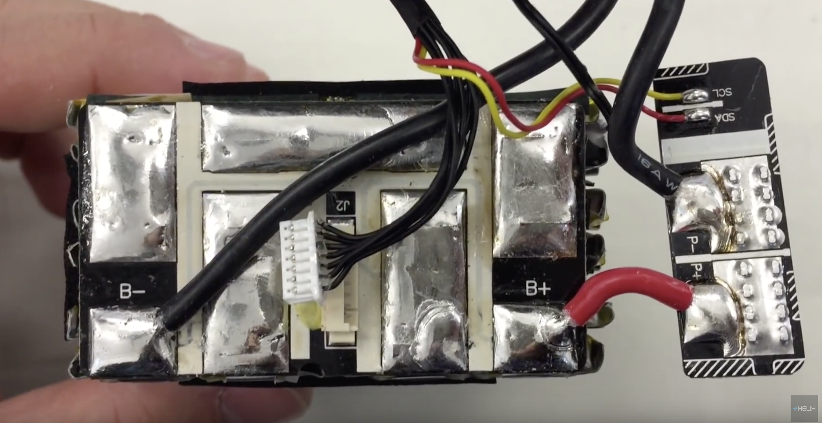

Slide 5
Does this just measure the
voltage of the individual cells?
To circuit board
Red and yellow wires: https://learn.sparkfun.com/tutorials/i2c
This part plugs
into the drone
Battery leads

Slide 6
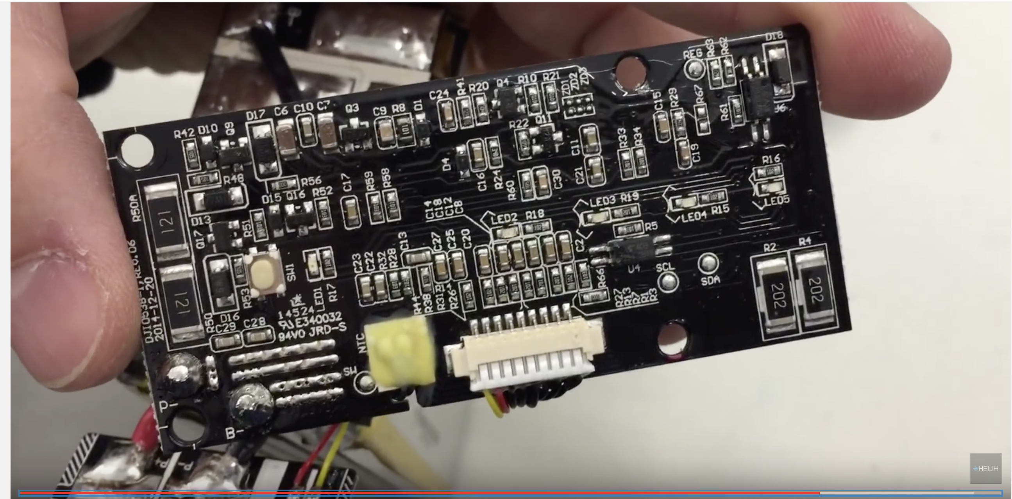
Logic board top

Slide 7
Inspire 1: estimates of hover Amp draw.
No estimate found for rise current
Varying numbers all around the internet
4500mAh battery supposed to give 15 or 18min hover time, corresponds to a 18A or 15A current
DJI Phantom (approx. half as heavy) rumored to be 13A at hover 25A max current.
DJI F550 (older drone) draws <30A according to youtube video

Slide 8
Patent for the Drone:
https://www.google.com/patents/US20140263823
Presentation by Manufacturer:
https://www.youtube.com/watch?v=vKht76-zRBI
- battery logic integrated fully within battery, counts charge cycles etc.

Slide 9
Red&Yellow wires are I2C protocol
https://learn.sparkfun.com/tutorials/i2c
SCL: Clock signal
SDA: Data signal
Get Flight logs:
https://support.dronesmadeeasy.com/hc/en-us/articles/206171443-Flight-Data-Log-Viewer-DJI-Phantom-3-and-Inspire-1

